Slide 1
Lecture 1
Basics of Antennas and Wave Propagation
Jatinder Singh
Assistant Professor
ECE Department
UIET, PU Chandigarh

Slide 2
Syllabus
Antennas & Wave Propagation(Theory) -EC503
        SECTION-A
Antenna Radiation:
Antenna Parameters: Antenna impedance, Directional patterns, Effective length, Radiation Intensity, Directivity, Power gain, Efficiency, Effective area, Equivalent circuit, Front to back ratio, polarization and antenna temperature, Radiation field, Radiation power, Radiation resistance, Directivity and gain of an alternating current element, half wave dipole and quarter wave monopole, Effect of earth on patterns. (15hours)
Antenna Arrays:
Multiplication of patterns, one dimensional broadside and endfire arrays, Feed network for arrays: series, shunt, delta matching, Impedance matching: Folded dipole, BALUNS and stubs, Yagi Uda array, log-periodic arrays, Dolph-Techebysheff arrays (10hours)

Slide 3
SECTION-B
Practical Antennas:
Top loading and tuning, rhombic antennas, ferrite rod, whip antennas, Receiving antennas, frequency independent antennas.(08hours)
Wave Propagation:
Modes of Propagation: Surface Wave Propagation, Sky Wave (Ionospheric) Propagation- Virtual height, Maximum usable Frequency, Skip Distance, Optimum working frequency, Space Wave (Tropospheric) Propagation- line of sight distance.(12hours)
Text Book:- Antennas and Radio Wave Propagation by K D Prasad

Slide 4
Course Objectives (CO)
To provide an in depth understanding of basic antenna parameters.
To provide in depth study for the analysis and design of antenna arrays.
To provide in depth study of Yagi-Uda array, log periodic array, and Dolph-Techebysheff arrays.
To provide in depth study of Practical Antennas such as rhombic antennas, ferrite rod, whip antennas.
To provide in depth study of special antennas such as frequency independent antennas and receiving antennas.
To study the effect of propagation of radio waves in actual environment.

Slide 5
Course Outcome
Explain basic Antenna parameters and special Analyze and design of antenna arrays.
Describe and analyze design parameters related to practical antennas
Explain the concept of propagation of radio waves.

Slide 6
Antenna Basics
An antenna can be a length of wire, a metal rod, or a piece of metal tubing OR
An antenna is an electrical conductor or system of conductors
  Transmission - radiates electromagnetic energy into space
  Reception - collects electromagnetic energy from space
In two-way communication, the same antenna can be used for transmission and reception
Antennas radiate most effectively when their length is directly related to the wavelength of the transmitted signal.
Most antennas have a length that is some fraction of a wavelength.
One-half and one-quarter wavelengths are most common.

Slide 7
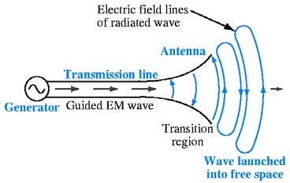
Antennas
An antenna is a device that provides a transition between guided electromagnetic waves in wires and electromagnetic waves in free space.

Slide 8
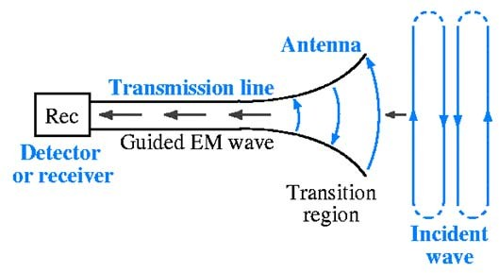
Reciprocity
Antennas can usually handle this transition in both directions (transmitting and receiving EM waves). This property is called reciprocity.

Slide 9
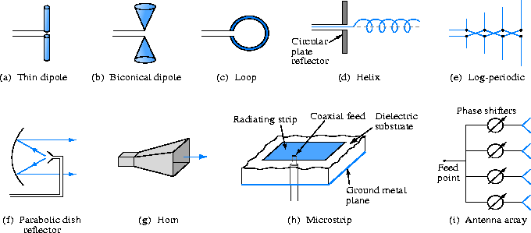
Antenna physical characteristics
The antenna’s size and shape largely determines the frequencies it can handle and how it radiates electromagnetic waves.

Slide 10
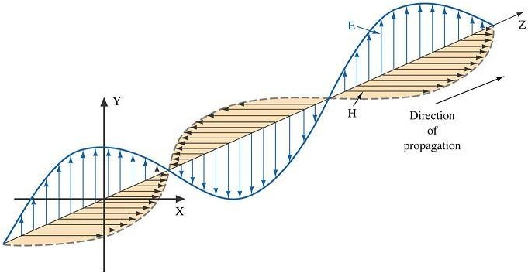
Antenna polarization
The polarization of an antenna refers to the orientation of the electric field it produces.
Polarization is important because the receiving antenna should have the same polarization as the transmitting antenna to maximize received power.
Antenna polarization
Horizontal Polarization
Vertical Polarization
Circular Polarization

Slide 11
Wavelength (λ)
You may recall from physics that wavelength (λ) and frequency (f ) of an electromagnetic wave in free space are related by the speed of light (c)
c = f λ or λ = ^{c}
f
Therefore, if a radio station is broadcasting at a frequency of 100 MHz, the wavelength of its signal is given
3.0 ×10⁸ m/s
λ = ^{c} =
= 3 m
f 100 ×10⁶ cycle/s
Wavelength and antennas
The dimensions of an antenna are usually expressed in terms of wavelength (λ).
Low frequencies imply long wavelengths, hence low frequency antennas are very large.
High frequencies imply short wavelengths, hence high frequency antennas are usually small.

Slide 12
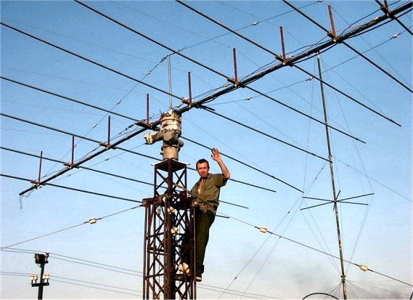
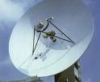
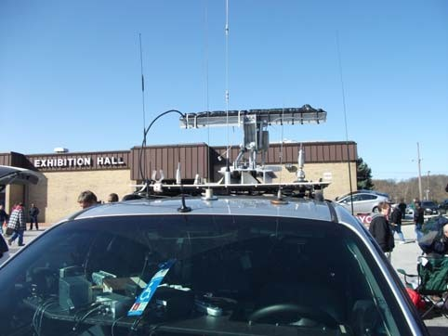


Slide 13
Types of Antennas
Isotropic antenna (idealized)
  Radiates power equally in all directions
Dipole antennas
  Half-wave dipole antenna (or Hertz antenna)
  Quarter-wave vertical antenna (or Marconi antenna)
Parabolic Reflective Antenna

Slide 14
Propagation Modes
Ground-wave propagation
Sky-wave propagation
Line-of-sight propagation

Slide 15
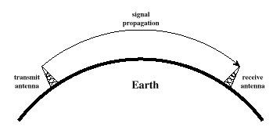
Ground Wave Propagation

Slide 16
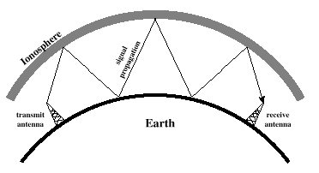
Sky Wave Propagation

Slide 17
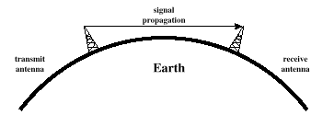
Line-of-Sight Propagation

